Slide 1


Computer Networks X_400487
Lecture 8
Chapter 5: The Network Layer—Part 2
Lecturer: Jesse Donkervliet

Slide 2
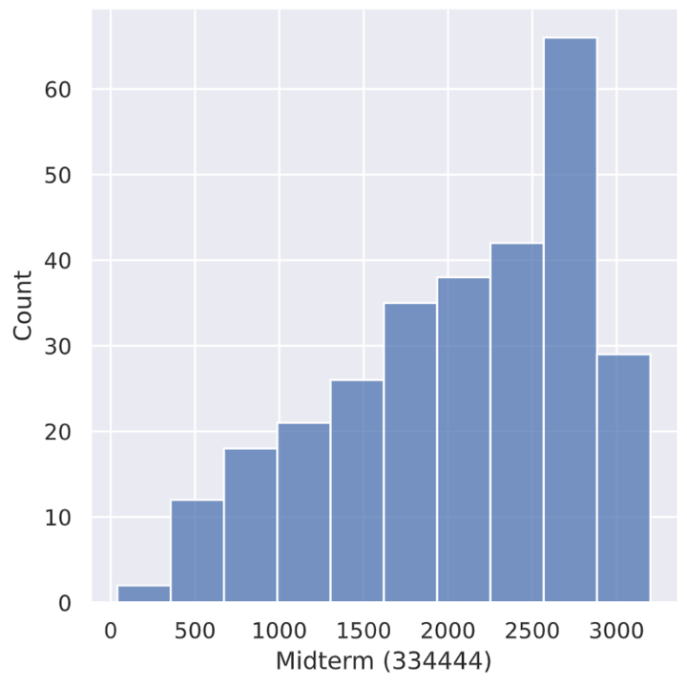
Well done at the Midterm!

Slide 3








ALL YOUR NETWORKS ARE BELONG TO IP!

Slide 4
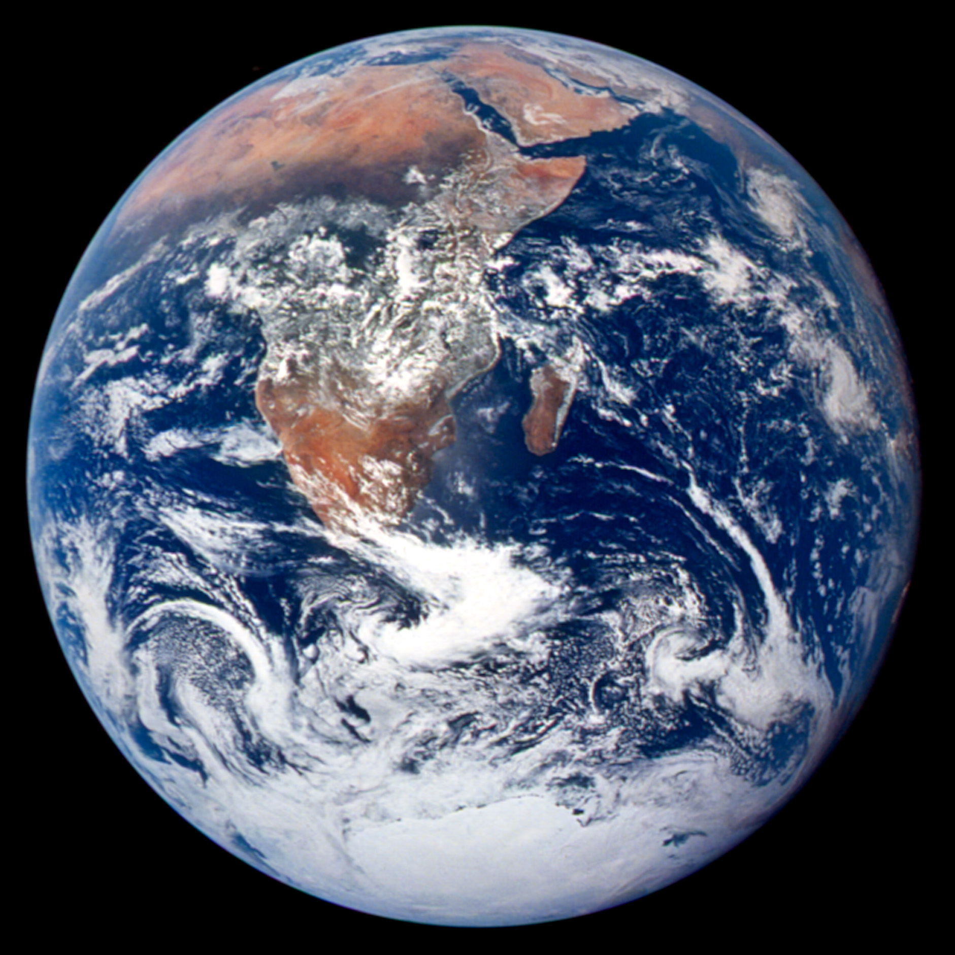
How to find a route between machines across the globe?
How does IP carry data over the Internet?
How to prevent network congestion?
How do routers manage the addresses of all these machines?
How to traverse networks with different protocols/properties/…
How to provide quality of Service?

Slide 5
How to find a route between machines across the globe?
How does IP carry data over the Internet?
How to prevent network congestion?
How do routers manage the addresses of all these machines?
How to traverse networks with different protocols/properties/…
How to provide quality of Service?

Slide 6
Quick Links for Today
IPv4
NAT
Subnets
Token Bucket

Slide 7
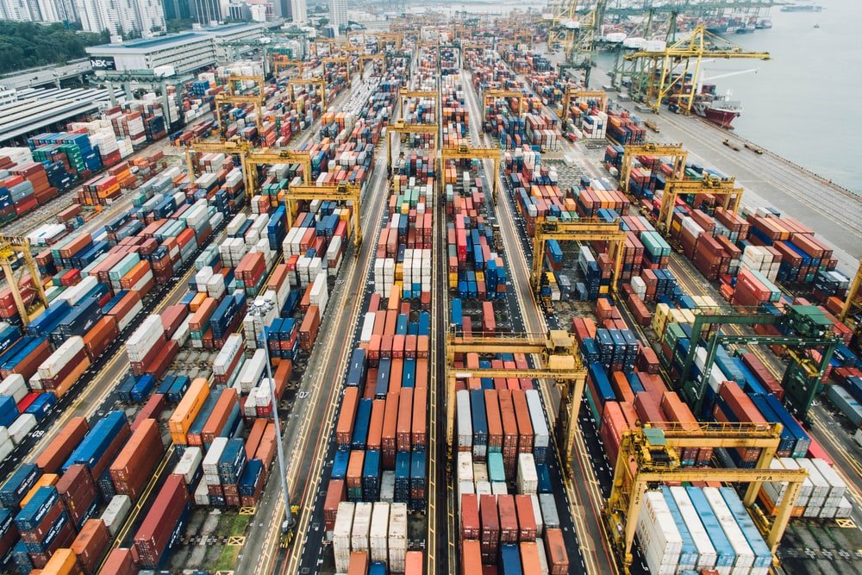
The Internet Protocol (IP)
Network Layer Protocol

Slide 8
Challenges Addressed by IPv4 Protocol Design
Error detection/correction
Preventing permanently looping packets
Globally identifying computers
Carrying packets over links with different size requirements

Slide 9
IP version 4
Frame header
32 bits wide
Version
IHL
Differentiated services
Total length
Identification
DF
MF
Fragment offset
Time to live
Protocol
Header checksum
Source address
Destination address
Options
Check the book for the detailed view!

Slide 10
IP version 4
Frame header
32 bits wide
Version
IHL
Differentiated services
Total length
Identification
DF
MF
Fragment offset
Time to live
Protocol
Header checksum
Source address
Destination address
Options
Q: What is the value of this field?

Slide 11
IP version 4
Frame header
32 bits wide
Version
IHL
Differentiated services
Total length
Identification
DF
MF
Fragment offset
Time to live
Protocol
Header checksum
Source address
Destination address
Options
Q: Why have this field?

Slide 12
Challenges Addressed by IPv4 Protocol Design
Error detection/correction
Preventing permanently looping packets
Globally identifying computers
Carrying packets over links with different size requirements

Slide 13
IP version 4
16 bit length field → packet size can reach 64KiB
Frame header
32 bits wide
Version
IHL
Differentiated services
Total length
Identification
DF
MF
Fragment offset
Time to live
Protocol
Header checksum
Source address
Destination address
Options
Q: Why have this field?

Slide 14

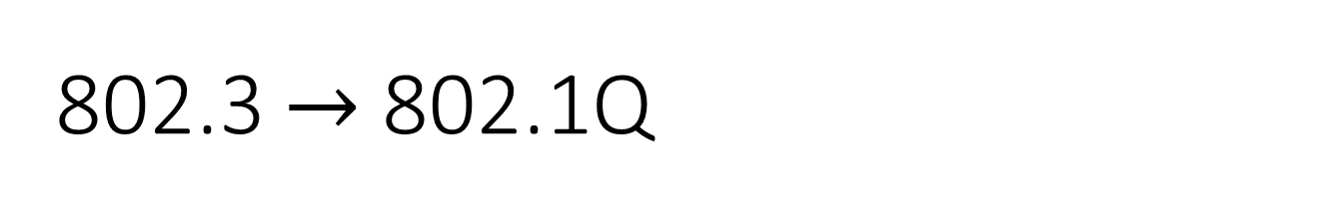
802.3 $→$ 802.1Q
VLAN type > 1500, interpreted as type
802.3 Frame layout
Preamble
Destination
address
Source
address
T/L
Data
P
CRC
Bytes: 8
6
6
2
0-1500
0-46
4
Maximum frame size differs across link-layer protocols!
802.1Q Frame modifications:
2
2
VLAN
Tag
Q: How do non-VLAN aware bridges handle these frames?
VLAN ID (color)
Pri
CFI
VLAN ID

Slide 15

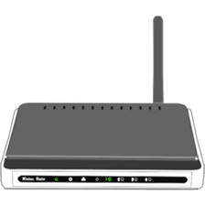
Packet fragmentation Transparent fragmentation
Q: What can cause packet size limits?
Packet size can be limited by hardware, software, protocols, law, etc.
Q: Can you name a (dis)advantage?
M
M
Packet too large for link
M
M
M
M
M
M
Max packet size: 10
Max packet size: 10
M
M
M
M
Max packet size: 3
Path Maximum Transmission Unit (MTU): 3

Slide 16
Packet fragmentation Nontransparent fragmentation
Used in IP!
Packet size can be limited by hardware, software, protocols, law, etc.
Q: Can you name a (dis)advantage?
M
M
M
Packet too large for link
M
M
M
M
M
M
M
Max packet size: 10
Max packet size: 10
M
M
M
M
Max packet size: 3
Path Maximum Transmission Unit (MTU): 3

Slide 17
Avoiding packet fragmentation MTU discovery
Packet size can be limited by hardware, software, protocols, law, etc.
Packet too large. Try 3!
M
Packet too large for link
M
Max packet size: 10
Max packet size: 10
Max packet size: 3
Path Maximum Transmission Unit (MTU): 3

Slide 18
Avoiding packet fragmentation MTU discovery
Used in IP!
Packet size can be limited by hardware, software, protocols, law, etc.
Q: Can you name a (dis)advantage?
M
M
M
M
M
M
Packet too large for link
M
M
M
M
M
M
Max packet size: 10
Max packet size: 10
M
M
M
M
Max packet size: 3
Path Maximum Transmission Unit (MTU): 3

Slide 19
IP version 4
Frame header
32 bits wide
Version
IHL
Differentiated services
Total length
Identification
DF
MF
Fragment offset
Time to live
Protocol
Header checksum
Source address
Destination address
Options
Q: Why have this field?

Slide 20
Challenges Addressed by IPv4 Protocol Design
Error detection/correction
Preventing permanently looping packets
Globally identifying computers
Carrying packets over links with different size requirements

Slide 21
IP version 4
Frame header
32 bits wide
Version
IHL
Differentiated services
Total length
Identification
DF
MF
Fragment offset
Time to live
Protocol
Header checksum
Source address
Destination address
Options
IPv4 does not use a CRC but a checksum.
Computed by adding all 16-bit half-words in the header

Slide 22
Challenges Addressed by IPv4 Protocol Design
Error detection/correction
Preventing permanently looping packets
Globally identifying computers
Carrying packets over links with different size requirements

Slide 23
IP version 4
Q: What service does IP not provide?
Frame header
32 bits wide
Version
IHL
Differentiated services
Total length
Identification
DF
MF
Fragment offset
Time to live
Protocol
Header checksum
Source address
Destination address
Options
Q: Why have this field?

Slide 24
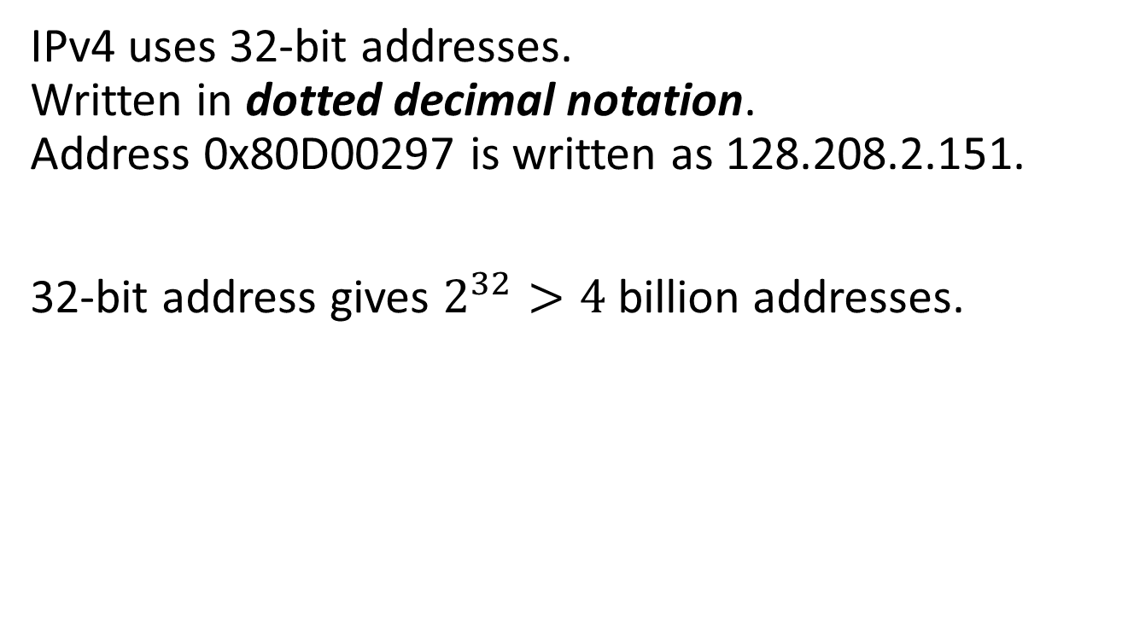
IPv4 addresses
IPv4 uses 32-bit addresses. Written in dotted decimal notation. Address 0x80D00297 is written as 128.208.2.151.
32-bit address gives $2^{32}>4$billion addresses.
Q: How to route packets to these addresses with latencies in the order of milliseconds?
Reduce routing table sizes using hierarchical routing!

Slide 25
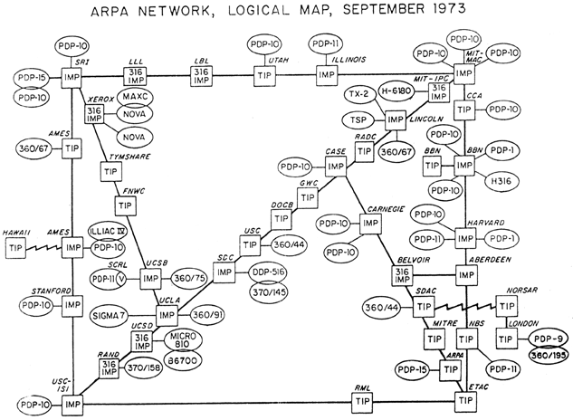

Slide 26
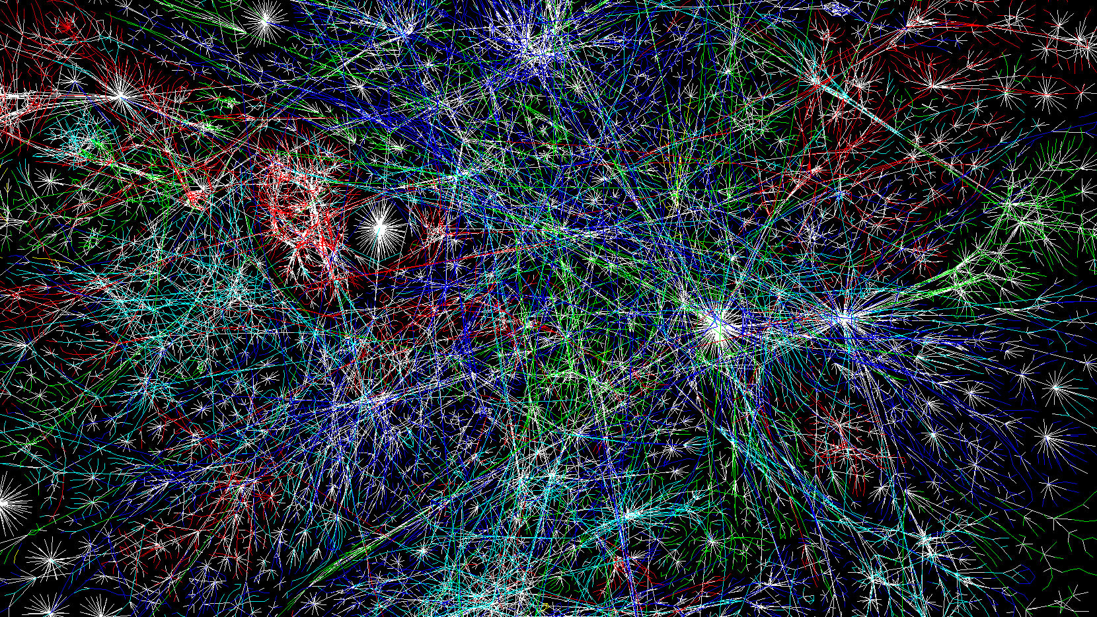
This ‘Internet’ thing is getting quite popular…

Slide 27


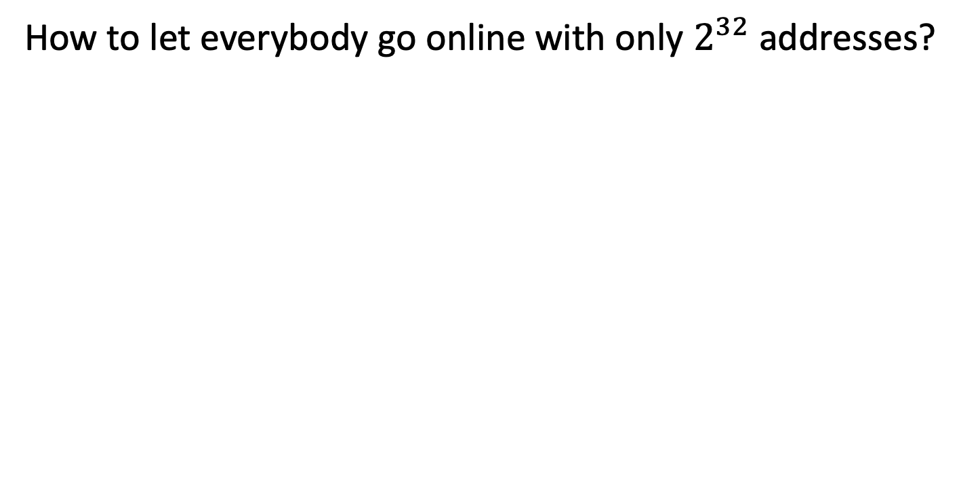
Network Address Translation (NAT)
Q: No headers left in IP header. How to implement this?
How to let everybody go online with only $2^{32}$ addresses?
Home
Outside
House/company has only one “external” IP address.
Network Address Translation Box
To ISP
Devices have their own “internal” IP address.

Slide 28

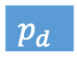


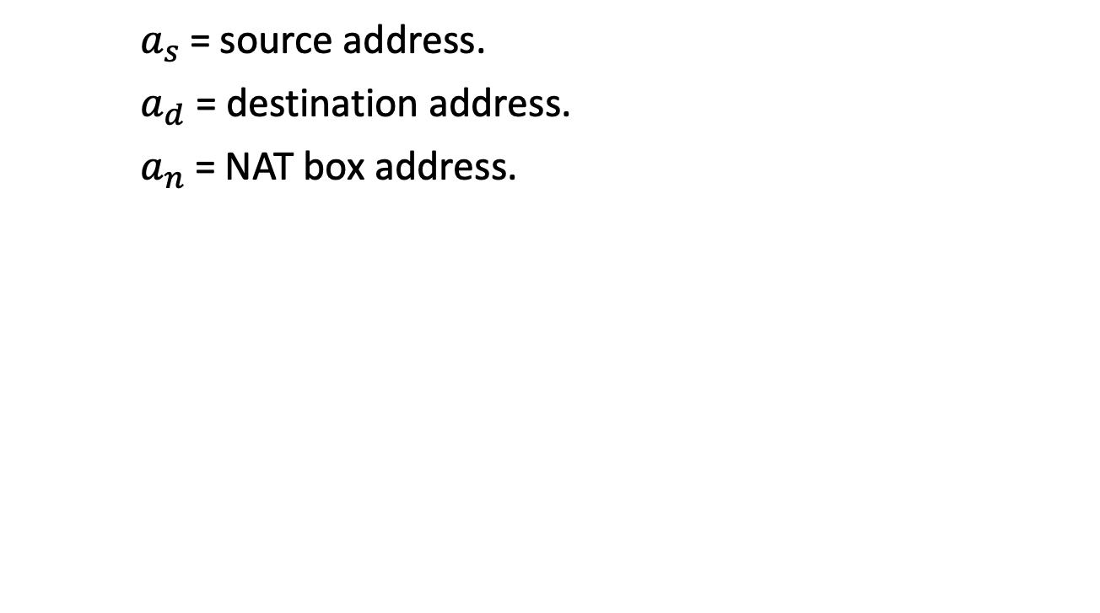

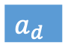


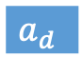

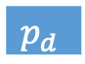
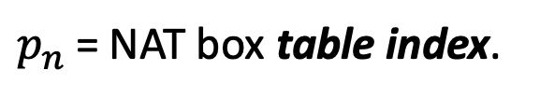






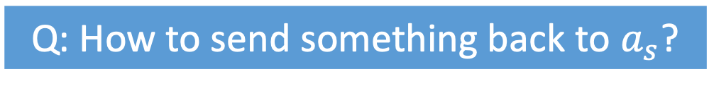






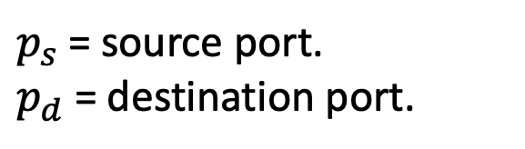
Network Address Translation (NAT)
Q: How to send something back to $a_{s}$?
$p_{s}$= source port.
$p_{d}$ = destination port.
$a_{s}$= source address.
$a_{d}$ = destination address.
$a_{n}$= NAT box address.
$$a_{s}$$
$$a_{d}$$
Home
Outside
$p_{n}$= NAT box table index.
$$p_{n}$$
:
$$a_{s}$$
$$p_{s}$$
NAT Box
$$a_{n}$$
$$M$$
$$M$$
A
A
T
$$p_{s}$$
$$p_{d}$$
$$p_{s}$$
$$p_{d}$$
T
T
$$p_{n}$$
$$p_{d}$$
$$p_{n}$$
$$p_{d}$$
T
N
$$a_{s}$$
$$a_{d}$$
$$a_{s}$$
$$a_{d}$$
N
N
$$a_{n}$$
$$a_{d}$$
$$a_{n}$$
$$a_{d}$$
N
D
D
D
D
P
P
P
P
Q: Objections to this approach?

Slide 29
Challenges Addressed by IPv4 Protocol Design
Error detection/correction
Preventing permanently looping packets
Globally identifying computers
Carrying packets over links with different size requirements

Slide 30
IP version 6
Multiple improvements over IPv4.
Many more addresses!
Simplified header – improves bandwidth/latency.
Easier to add options in the header.
Improved security support.
Backported to IPv4

Slide 31
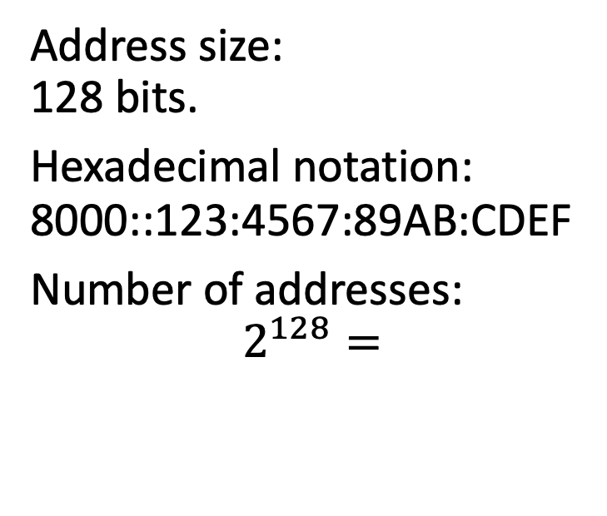
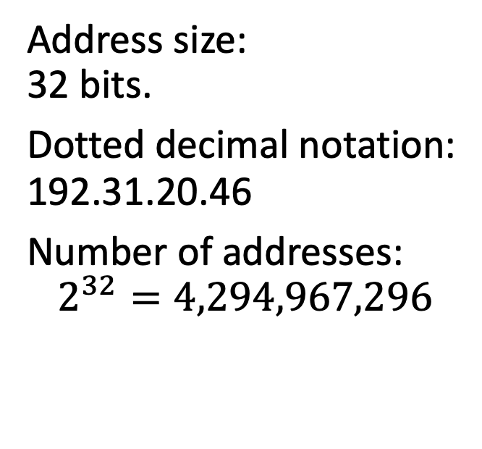
IP version 6
IP version 4
IP version 6
Address size: 32 bits.
Dotted decimal notation: 192.31.20.46
Number of addresses:
$$2^{32}=4,294,967,296$$
Address size: 128 bits.
Hexadecimal notation: 8000::123:4567:89AB:CDEF
Number of addresses: $$2^{128}=$$
$$340,282,366,920,938,463,463,374,607,431,768,211,456$$
That’s a lot!

Slide 32
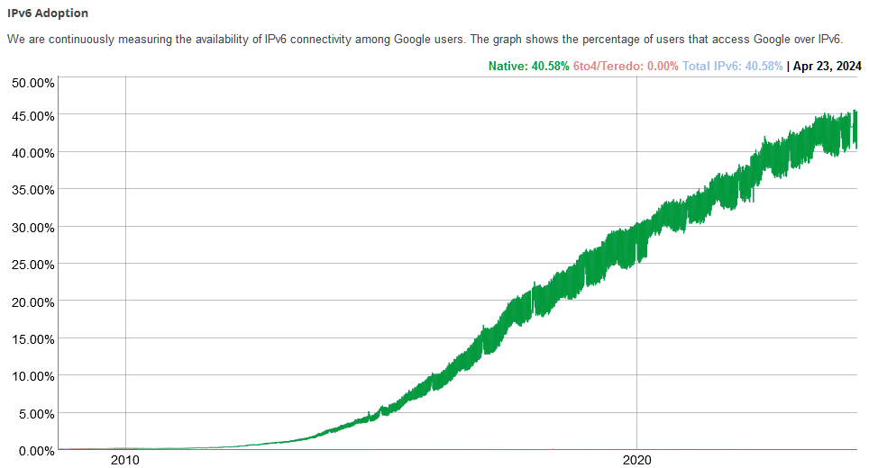
Hit the 40% milestone in 2022!
Hit the 30% milestone in 2020!
Q: Why is it taking so long?

Slide 33



Connecting Networks with Different Protocols
If source and destination networks use different protocols, they cannot communicate.
Network A:
Uses ‘cars’ protocol.
Network B:
Uses ‘boats’ protocol.
Network C:
Uses ‘planes’ protocol.

Slide 34
Tunneling
Used to route IPv6 packets over IPv4 networks
Q: Can you name a (dis)advantage?
If an intermediate network uses different protocols, they can communicate by tunneling.
Network type A
Network type A
source
destination
Routers support both types of network!
Network type B

Slide 35
Business as usual Packets in packets in packets in …
Data wrapped in headers from multiple networking layers.
data
Application layer
T
data
Transport layer
Network Layer
N
d
data
Data link layer
L
d
d
data
L
Medium Access Control
Physical layer
signals

Slide 36
Tunneling Packets in packets in packets in …
Data wrapped in headers from multiple networking layers.
Network-layer packet used as payload for other network-layer packet
data
Application layer
T
data
Transport layer
Network Layer
N
d
data
Data link layer
N
d
d
data
Medium Access Control
Physical layer
signals
L
d
d
d
data
L

Slide 37
IP version 6
Frame header
32 bits wide
Version
Differentiated services
Flow label
Payload length
Next header
Hop limit
Source address
Destination address

Slide 38
IP version 6
Value 0x06 to indicate IP version 6
Frame header
32 bits wide
Version
Differentiated services
Flow label
Payload length
Next header
Hop limit
Source address
Destination address

Slide 39
IP version 6
“Time to live” renamed to “Hop limit”
Frame header
32 bits wide
Version
Differentiated services
Flow label
Payload length
Next header
Hop limit
Source address
Destination address

Slide 40
IP version 6
Specifies transport layer protocol or extension header
Frame header
32 bits wide
Version
Differentiated services
Flow label
Payload length
Next header
Hop limit
Source address
Destination address

Slide 41
Addressing the Problem of Too Many Addresses to Route
Managing the size of routing tables

Slide 42
Internet Protocol Prefixes and Subnets
Routing algorithms can calculate routes to prefixes, instead of to every individual address
Vrije Universiteit given a prefix. E.g., all IP addresses that match 37.60.x.y.
Example address: 37.60.194.64.
00100101.00111100.11000010.01000000
Prefix: 37.60.0.0/16 Subnet mask: 11111111.11111111.00000000.00000000
Address starts with 37.60?
If yes, route to VU.
Prefixes handed out by single organization: ICANN
Organizations can further subdivide their prefix to create subnets
Network
Host
16 bits used by network

Slide 43
Internet Protocol - CIDR Classless InterDomain Routing
TU Delft
37.62.0.0/15
C
00100101.00111110.00000000.00000000
D
B
A
VU
37.60.0.0/16
M
00100101.00111100.00000000.00000000
UvA
37.61.0.0/16
E
37.62.0.0/15 – B
37.60.0.0/16 – B
37.61.0.0/16 – B
00100101.00111101.00000000.00000000

Slide 44
Internet Protocol - CIDR Classless InterDomain Routing
First 14 bits are all equal!
TU Delft
37.62.0.0/15
C
00100101.00111110.00000000.00000000
D
B
A
VU
37.60.0.0/16
00100101.00111100.00000000.00000000
M
UvA
37.61.0.0/16
E
37.62.0.0/15 – B
37.60.0.0/16 – B
37.61.0.0/16 – B
00100101.00111101.00000000.00000000

Slide 45
Internet Protocol - CIDR Classless InterDomain Routing
First 14 bits are all equal!
TU Delft
37.62.0.0/15
C
00100101.00111110.00000000.00000000
D
B
A
VU
37.60.0.0/16
00100101.00111100.00000000.00000000
M
UvA
37.61.0.0/16
E
37.60.0.0/14 – B
00100101.00111101.00000000.00000000
Reducing routing table size through route aggregation

Slide 46
Longest Matching Prefix
Consider the following routing table:
An incoming IP packet carries the destination address 137.70.32.128. On which port is this packet forwarded? Assume that the router uses the longest matching prefix.
Prefix | Port | Binary
137.70.32.192/26 | A | 10001001.01000110.00100000.11000000
137.70.32.0/20 | B | 10001001.01000110.00100000.00000000
137.64.0.0/10 | C | 10001001.01000000.00000000.00000000
0.0.0.0/0 | D | 00000000.00000000.00000000.00000000
137.70.32.128
10001001.01000110.00100000.10000000

Slide 47
Internet Control Message Protocol (ICMP)
Network Layer Protocol

Slide 48
Internet Control Message Protocol (ICMP)
If something goes wrong, routers send these messages to senders.
Some examples:
Destination unreachable
Time exceeded
“Echo” and “echo reply”
Router advertisement/solicitation
Packet needs fragmentation / packet too big
Used by the program traceroute
Used by the program ping

Slide 49
Dynamic Host Configuration (DHCP)
Network Layer Protocol

Slide 50

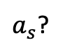
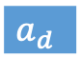

Dynamic Host Configuration Protocol (DHCP)
MAC addresses are built into NICs. But network addresses are not.
Used to configure other settings such as: network mask, addresses of default gateway, DNS, time servers, etc.
Wait, what is my IP address?
DHCP packet. A machine without an IP address requests to get one assigned.
$$M$$
Somewhere, a DHCP server received the request and offers an available address.
A
T
$a_{s}$?
DHCP discover
N
$$a_{s}$$
$$a_{d}$$
DHCP offer
$$a_{s}$$
D
P
Q: How to send DHCP offer back to machine without an address?

Slide 51
Address Resolution Protocol (ARP)
Network Layer Protocol

Slide 52

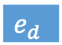

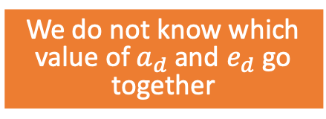
Address Resolution Protocol (ARP)
Q: Problems with this approach?
$$a_{s}$$
$$M$$
A
T
N
$$a_{s}$$
$$a_{d}$$
We do not know which value of $a_{d}$ and $e_{d}$ go together
D
$$e_{s}$$
$$e_{d}$$
P

Slide 53
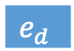
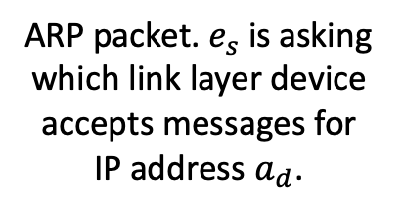
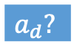
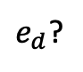

Address Resolution Protocol (ARP)
Q: Problems with this approach?
$$a_{s}$$
Request is broadcast over Ethernet.
ARP packets wrapped in Ethernet frames.
ARP packet. $e_{s}$is asking which link layer device accepts messages for IP address $a_{d}$.
$$M$$
A
Station replies with ARP packet containing its IP (and MAC) address.
T
$e_{d}$?
$$a_{d}?$$
N
$$a_{s}$$
$$a_{d}$$
$$a_{d}$$
$$e_{d}$$
D
$$e_{s}$$
$$e_{d}$$
P

Slide 54
Network-Layer Resource Allocation

Slide 55
Two Main Service Types
Connectionless service:
Connection-oriented service:
B
B
M
M
M
M
M
M
M
M
M
M
M
A
M
A
M
M

Slide 56
Connectionless Service Datagrams
Routers use routing algorithms to decide where to send each packet individually.
B
M
M
M
M
M
A
M
Used by the Internet Protocol (IP).
M

Slide 57
Connection-Oriented Service Virtual Circuits
Decide fixed route during connection setup.
All packets part of the connection follow this route.
B
M
M
M
M
M
M
ISPs can use this on top of IP.
A
M
Q: What kind of parameters are
negotiated during connection setup?

Slide 58

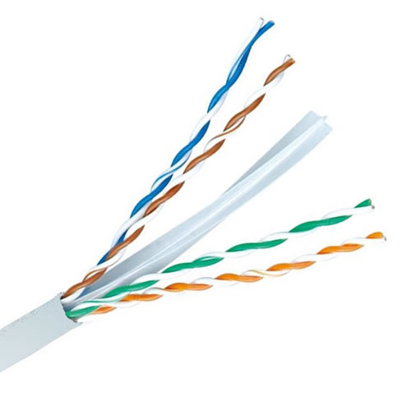
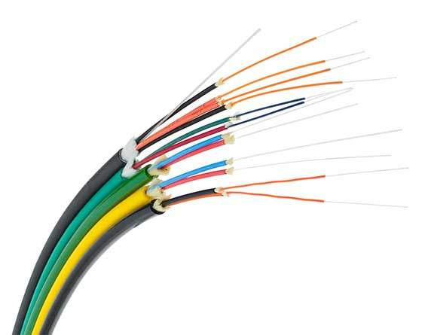


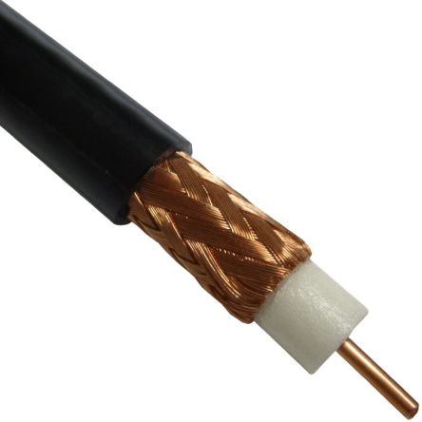
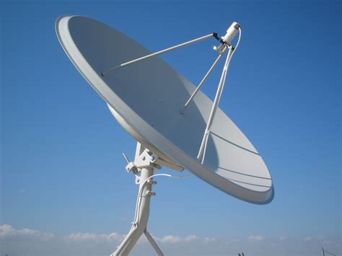
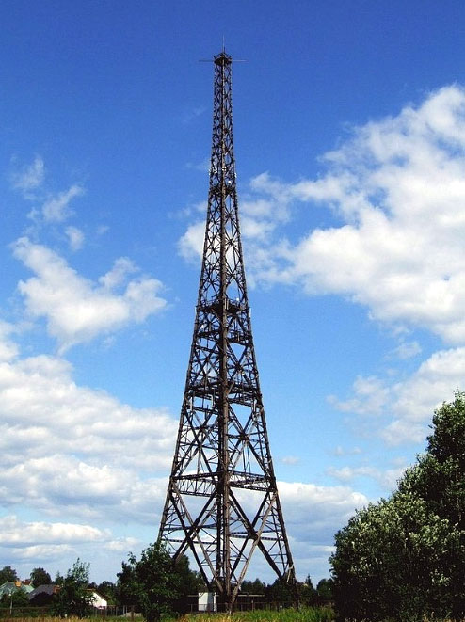


Service comparison
The “best” service depends on your use case
Datagrams
Virtual Circuits
No setup required
Easy congestion control
Router failures have low impact
Easy Quality of Service guarantees
Packets contain full addressing information. Routers are stateless.
Packets contain VC number. Routers keep track of active VCs.
Complexity moved. No free lunch

Slide 59
How to find a route between machines across the globe?
How does IP carry data over the Internet?
How to prevent network congestion?
How do routers manage the addresses of all these machines?
How to traverse networks with different protocols/properties/…
How to provide Quality of Service?

Slide 60
Congestion control
Preventing traffic jams

Slide 61


Looking back on flow control
Mechanism in data link layer.
Makes sure a sender does not send information faster than a receiver can accept.
Adding lots of buffer space.
Q: What can go wrong?
Q: Did we fix the issue?

Slide 62
Congestion control
Goodput: rate of useful packets arriving at the receiver
Combined responsibility of the network and transport layers.
Ideal response
Network capacity
Desired response
Effective bandwidth
“Goodput”
Congestion collapse
Network load

Slide 63
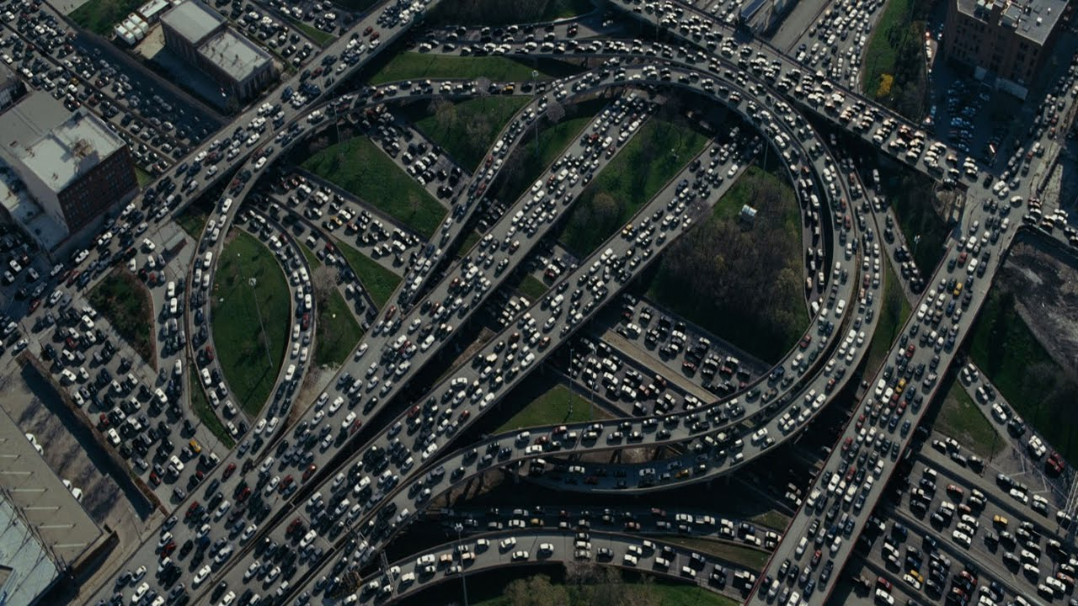
Approaches to congestion control
How can we fix this?

Slide 64
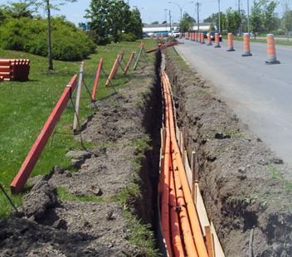
Approaches to congestion control
Can we do something smarter?
Simplest approach is resource over-provisioning.
Preventing congestion by installing more bandwidth.

Slide 65
Traffic-aware routing
4
1
If link costs are static, all traffic is routed over lowest-cost links.
7
1
10
9
5
2
8
5
2
2
6
1
3
3
3
1
9
5

Slide 66
Traffic-aware routing
4
1
Using dynamic cost calculation can prevent congestion.
7
1
10
9→1
5
2
8
5
2
2
6
1
3
3
3
1→9
9
5

Slide 67
Traffic-aware routing
4
1
Using dynamic cost calculation can prevent congestion.
7
1
10
9→1
5
2
8
5
2
2
6
1
3
3
3
1→9
9
5
Can you think of a problem with this approach?
Calculate link cost as a function of current load

Slide 68
Traffic-aware routing
4
1
Using dynamic cost calculation can prevent congestion.
7
1
10
9←1
5
2
8
5
2
2
6
1
3
3
3
1←9
9
5
Can you think of a problem with this approach?
Calculate link cost as a function of current load

Slide 69
Traffic-aware routing
Q: Can think of a (dis)advantage?
4
1
Using dynamic cost calculation can prevent congestion.
Need to prevent oscillations.
Small cost updates.
Multiple paths.
7
1
10
9→1
5
2
8
5
2
2
6
1
3
3
3
1→9
9
5
Calculate link cost as a function of current load

Slide 70
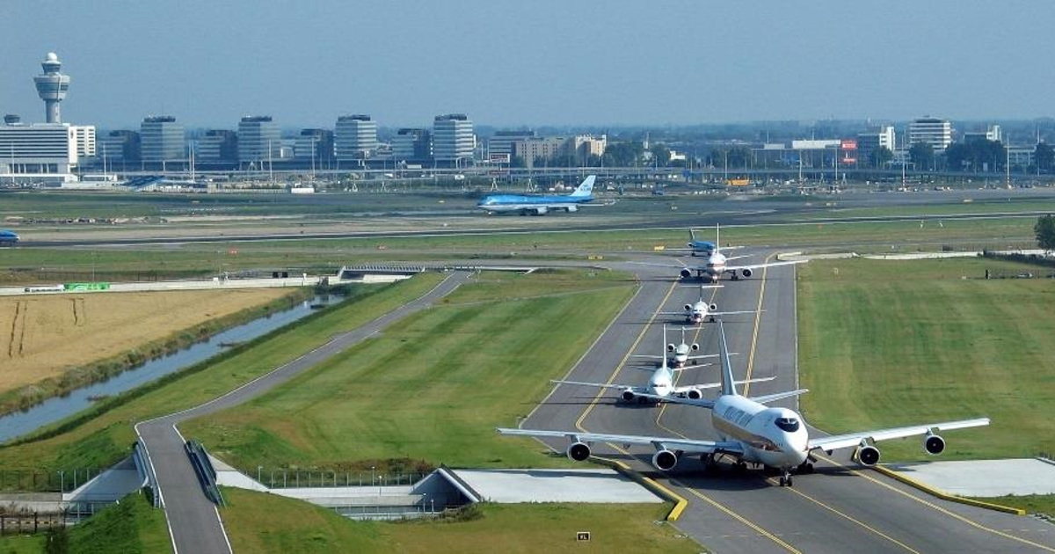
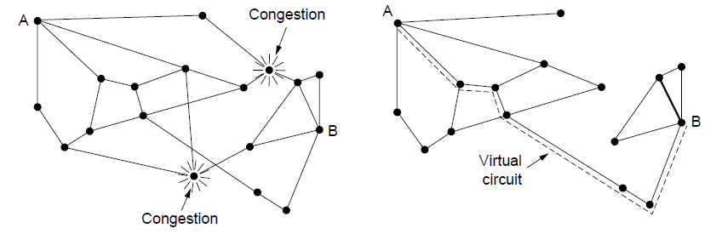
Admission control
Admission Control
If there is congestion, new traffic has to wait!

Slide 71
Admission control
Admission control allows a new traffic load only if the network has sufficient capacity.
4
7
1
8
2
6
3
9
5

Slide 72
Admission control
Admission control allows a new traffic load only if the network has sufficient capacity.
Can you find a path that does not result in congestion?
4
7
1
8
2
6
3
9
5

Slide 73
Admission control
Admission control allows a new traffic load only if the network has sufficient capacity.
Can you find a path that does not result in congestion?
4
7
1
8
2
6
3
9
5

Slide 74
Admission control
Admission control allows a new traffic load only if the network has sufficient capacity.
Can you find a path that does not result in congestion?
4
7
1
8
2
6
3
9
5

Slide 75
Admission control
Admission control allows a new traffic load only if the network has sufficient capacity.
Can you find a path that does not result in congestion?
4
7
1
8
2
6
3
9
5

Slide 76
Admission control
Admission control allows a new traffic load only if the network has sufficient capacity.
Can you find a path that does not result in congestion?
4
7
1
8
2
6
3
9
5

Slide 77
Admission control
Q: Can think of a (dis)advantage?
Admission control allows a new traffic load only if the network has sufficient capacity.
Can you find a path that does not result in congestion?
Yes: allow traffic.
No: traffic must wait
4
7
1
8
2
6
3
9
5

Slide 78
Traffic throttling
Send messages in the opposite direction to explicitly indicate network congestion.
Most common implementation:
Set special bits in IP packet.
Inform sender of congestion through TCP.

Slide 79
Traffic throttling End-to-end
Q: Can think of a (dis)advantage?
Send back a ‘choke’ signal. When the source receives this packet, it slows down transmission.
Used in TCP/IP via Explicit Congestion Notification (ECN).
Overloaded!
choke
choke
M
M
choke
M
M

Slide 80
Traffic throttling Link-by-link
Q: Can think of a (dis)advantage?
Send back a ‘choke’ signal. Every router that receives this packet slows down transmission.
Overloaded!
choke
choke
M
M
choke
M
M

Slide 81
Traffic Shaping
Regulating Network Resource Usage

Slide 82
Looking back on flow control
Mechanism in data link layer.
Makes sure a sender does not send information faster than a receiver can accept.
Adding lots of buffer space.
Q: What can go wrong?
Q: Did we fix the issue?

Slide 83
Congestion control
Goodput: rate of useful packets arriving at the receiver
Combined responsibility of the network and transport layers.
Ideal response
Network capacity
Desired response
Effective bandwidth
“Goodput”
Congestion collapse
Network load

Slide 84
Approaches to congestion control
How can we fix this?

Slide 85
Traffic shaping
Challenge: limit available data data rate, but allow bursty traffic
Regulates rate and burstiness of data entering the network.
Traffic flow
Traffic
shaping
Host
Packets
Network

Slide 86

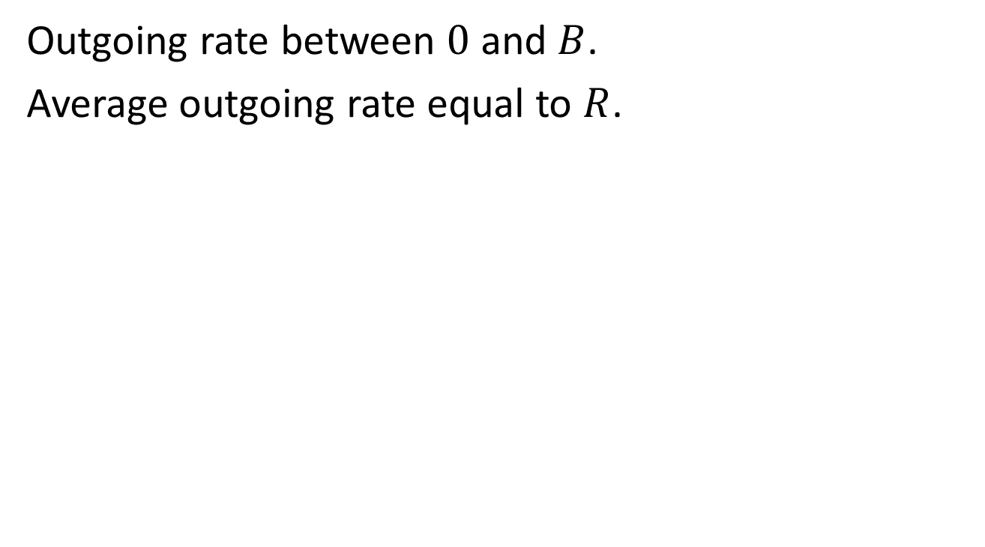
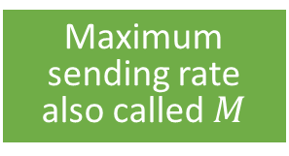
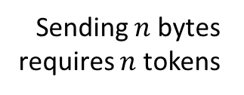
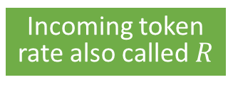
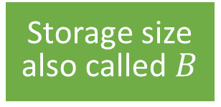
Traffic shaping Token bucket
Maximum burst duration is $\frac{B}{M−R}$ seconds
Outgoing rate between $0$ and $B$.
Average outgoing rate equal to $R$.
Incoming token rate also called $R$
Tokens comes in at constant rate
Maximum sending rate also called $M$
Sending $n$ bytes requires $n$ tokens
Storage size also called $B$
Bucket can store a limited number of tokens
Token Bucket

Slide 87
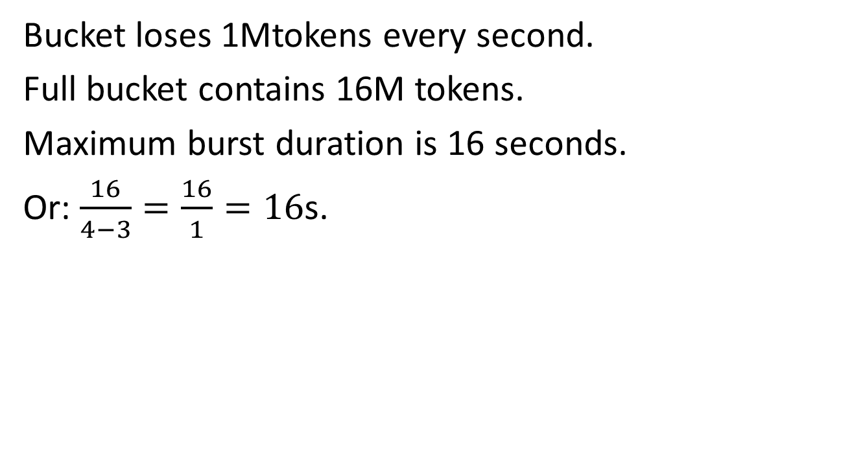
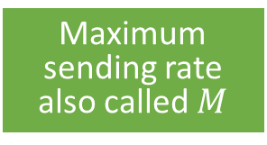
Traffic shaping Token bucket example
Maximum burst duration is $\frac{B}{M−R}$ seconds
Bucket loses 1Mtokens every second.
Full bucket contains 16M tokens.
Maximum burst duration is 16 seconds.
Or: $\frac{16}{4−3}=\frac{16}{1}=16$s.
Incoming token rate also called $R$
Tokens comes in at 3 Mtokens/s
Maximum sending rate also called $M$
Machine wants to send 4 MB/s
Q: What happens after 16s?
Storage size also called $B$
Bucket can store 16M tokens
Token Bucket

Slide 88
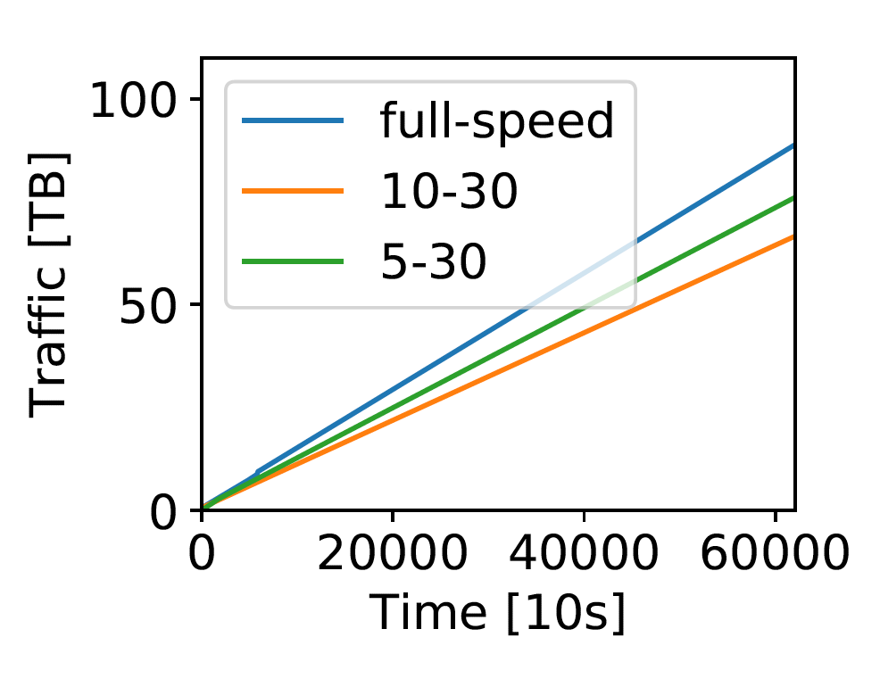
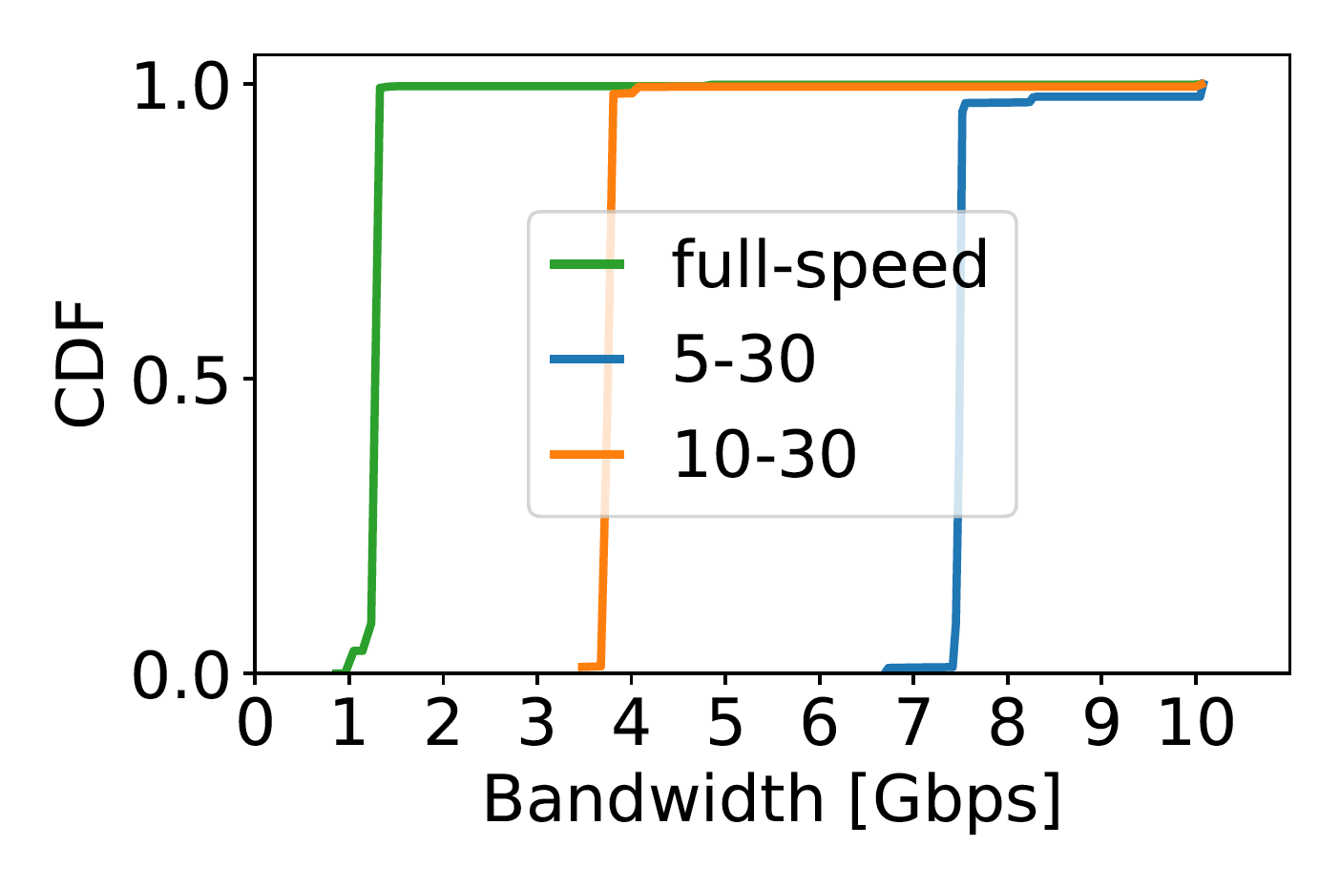
Traffic Shaping in Cloud Networks
Traffic shaping being used in practice

Slide 89
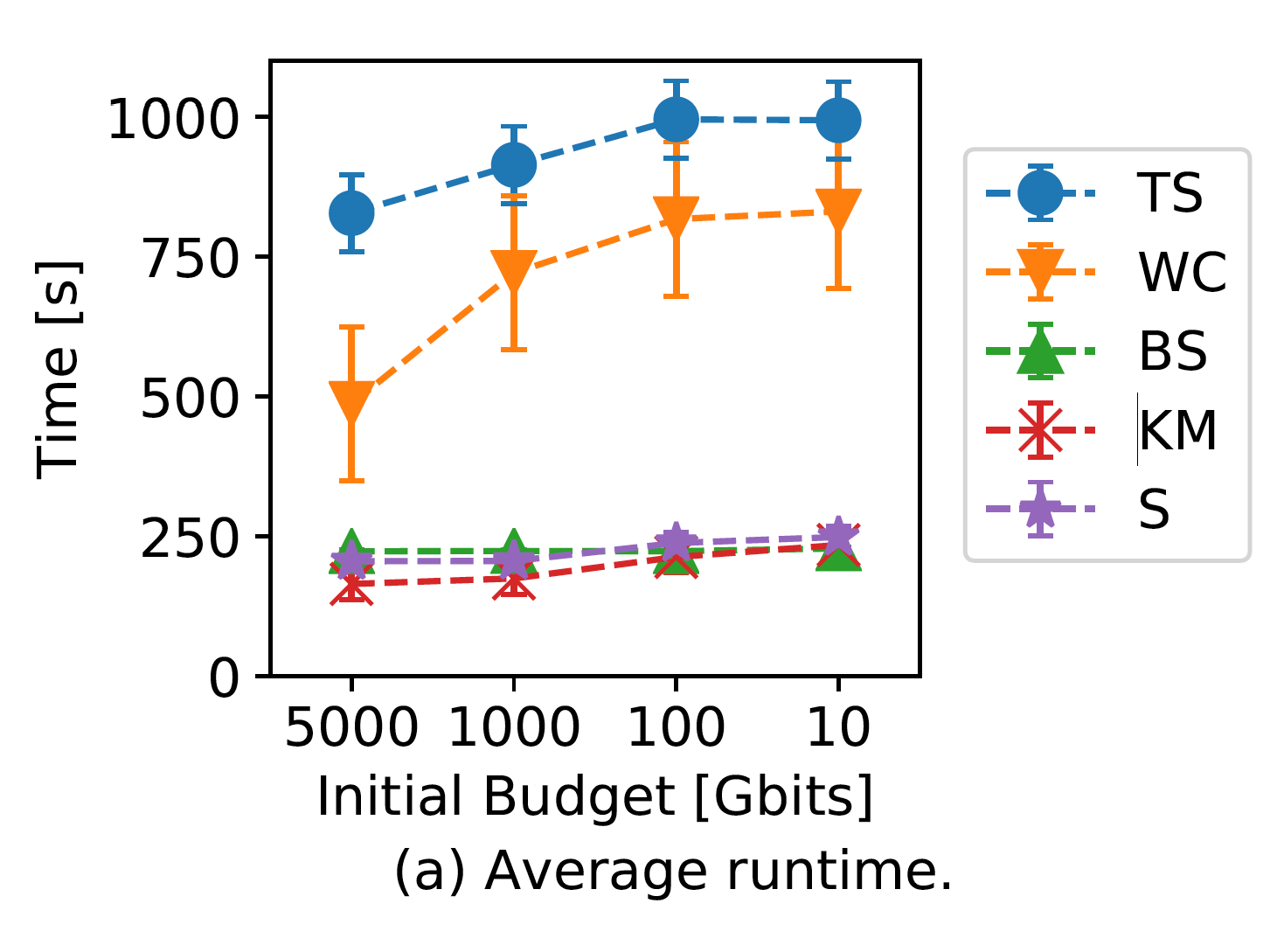
Traffic Shaping in Cloud Networks
Traffic shaping affecting performance

Slide 90

Load shedding
Load Shedding
For if all else fails. Choosing partial failure over total system failure.
Choosing partial failure over total system failure

Slide 91

Load Shedding Random Early Detection (RED)
Drop packets randomly if buffer space is almost full.
Sends an implicit signal to the sender: slow down!
Notices packet loss. Concludes network congestion. Slows down.
Almost overloaded!
M
Q: What happens now?
M

Slide 92
Load shedding
Works if transmission errors are unlikely cause of packet loss.
Wired links are reliable (errors are unlikely)
Wireless channels (and other unreliable channels) need to solve transmission errors on the data link layer to hide them from network layer

Slide 93
Quality of Service
We will revisit this problem in later lectures. It is interesting that we encounter this problem at the link layer, but do not have the abililty to solve it without help from higher layers.
Computer networks traditionally offer best-effort service
Tries to get data from A to B, but no promises
Q: How is this solved in practice?
Hosts provide reliable delivery using retransmissions
Q: What is the problem with this approach?
Does not work (well) for many applications:

Slide 94
Quality of Service and its parameters
Bandwidth
Maximum data rate. Measured in bits per second
Delay
Time it takes to get from source to destination
Jitter
Variation in packet delay.
0 jitter means delay is constant
Packet loss
Probability of packets being dropped

Slide 95



Different applications have different requirements
A
B
strict requirement
A
B
weak requirement
File sharing
Bandwidth
Audio on demand
Delay
Video on demand
Jitter
Telephony
Packet loss
Videoconferencing

Slide 96
Different applications have different requirements
A
B
strict requirement
A
B
weak requirement
File sharing
Bandwidth
Audio on demand
Delay
Video on demand
Jitter
Telephony
Packet loss
Videoconferencing

Slide 97
Different applications have different requirements
A
B
strict requirement
A
B
weak requirement
File sharing
Bandwidth
Audio on demand
Delay
Video on demand
Jitter
Telephony
Packet loss
Videoconferencing

Slide 98
Different applications have different requirements
A
B
strict requirement
A
B
weak requirement
File sharing
Bandwidth
Audio on demand
Delay
Video on demand
Jitter
Telephony
Packet loss
Videoconferencing

Slide 99
Different applications have different requirements
A
B
strict requirement
A
B
weak requirement
File sharing
Bandwidth
Audio on demand
Delay
Video on demand
Jitter
Telephony
Packet loss
Videoconferencing

Slide 100
Different applications have different requirements
A
B
strict requirement
A
B
weak requirement
File sharing
Bandwidth
Audio on demand
Delay
Video on demand
Jitter
Telephony
Packet loss
Videoconferencing

Slide 101
Quiz Time!
10-15(?) minutes
Correct answers without explanation do not get points!
Please do not use external resources, including:
ChatGPT (forget AI, use and train your RI [Real Intelligence!])
Anything on or via the Internet (the Web, chat apps, etc)
Answers from your neighbors
The book / slides

Slide 102
Network Layer Summary
Networking
Routing Algorithms:
Distance Vector
Link State
Hierarchical
Problem of scale: too many addresses
Not enough address space (solved by IPv6)
Routing tables too large (problem reduced by aggregation)
Network configuration
Obtaining an address (DHCP)
Looking up corresponding MAC address (ARP)
Internetworking
Different networks have different properties
Using a common protocol (IP).
Tunneling through networks with other protocols.
MLPS supports multiple protocols, for faster switching
Within Autonomous Systems (e.g., OSPF)
Between Autonomous Systems (e.g., BGP)
Resource Management
Connectionless and Connection-oriented approaches
Congestion Control (RED, ECN, etc.)
Traffic Shaping (Token Bucket, Leaky Bucket)

